Slide 1
Core IT - CDS Design
– Phase 1 and 2.1
Kevin Co
Avanade
Version 2.4
Notes:
V1.2

Slide 2
Version History – 1/2
Version | Date | Authors | Comments
1.0 | 21/12/2021 | Kevin Co | Version presented to Soumith Rao, Chris Muldoon, Tony Sheehy (CFS) 21/12/2021 Version presented to Fabian Magrini (Digital CFS) 22/12/2021 Version submitted for endorsement 23/12/2021
1.1 | 04/02/2022 | Kevin Co | Upon request by client, updated with onboarding approach for other work-pack streams / teams Added slide “CI, CD and branching”. Added more detail about branching. Renamed master branch to main branch. Made corrections to phase 1 items: “Architectural decision records as MarkDown” is more for Digital. “Deploy + Test + Destroy” is not in phase 1 scope. Version submitted for endorsement 04/02/2022
1.2 | 08/02/2022 | Kevin Co | Meeting with John Stannard and Soumith (08/02/2022), will approach the onboarding of TCS (WP2, WP3) via a separate/new code repository forked from the VDC code repository. Added this detail to the “Onboarding other teams - Approach” slide. Fabian asked about hotfix approach. I have added some detail on the Branching Strategy slide, and updated diagrams. Version submitted for endorsement 08/02/2022
2.0 | 16/03/2022 | Kevin Co | Took file “PWP1DL3-CDS-Avanade - CFS Core IT - WP1 - Design.pptx” (version 1.2) and aligned to CFS pptx template. Copied to “PWP1DL3-CDS-Avanade - CFS Core IT - WP1 - Design-FINAL-v2.0.pptx”.
2.1 | 16/03/2022 | Kevin Co | Added phase 2.1 components. Draft version circulated with client on 16/03/2022.
2.2 | 21/03/2022 | Kevin Co | Phase 2.1 content: self-hosted agents and runners. Draft version circulated with client on 21/03/2022.

Slide 3
Version History – 2/2
Version | Date | Authors | Comments
2.3 | 24/03/2022 | Kevin Co | More Phase 2.1 content. Final version 2.3 circulated with client on 24/03/2022 – sent to client as “PWP1DL3-CDS-Avanade - CFS Core IT - WP1 - Design-FINAL-v2.3.pptx”.
2.4 | 29/03/2022 | Kevin Co | Corrected content for Post-Phase 2.1 (Phase 2.1+) - the previous content was the view of the proposed work/roadmap, at the time of phase 1. Re-aligned with HLSD with regards to non-prod Azure DevOps Agents – they will be built, with purpose they can be used to modify IaaS, where AZ CLI does not suffice. Final version 2.4 circulated with client on 29/03/2022 - Sent to client as “PWP1DL3-CDS-Avanade - CFS Core IT - WP1 - Design-FINAL-v2.4.pptx”.

Slide 4
Introduction
Phase 1
CDS is the platform that will provide continuous integration and delivery in the Core IT program
The first phase of the Core IT program covers IaC for Virtual Data Centre – this document is written in that context.
At later phases, further work will enable CI/CD for applications and services workloads.
Phase 2.1
Phase 2.1 of the Core IT program (WP1) covers IaC for Virtual Data Centre and additional components for the DevOps ecosystem – this document is written in that context.
Self-hosted GitHub Actions runners.
Self-hosted Azure DevOps agents.
A sample 2-tier web app – hosted on Azure App Service and SQL PaaS.
Sample tests for BlazeMeter and BrowserStack.
GitHub package registry for use in CI and application development.
Notes:
Modified/added for phase 2.1

Slide 5
Overall Approach
Provision GitHub Enterprise Cloud – Enterprise Managed Users (EMU) with AAD as IdP.
Provision Azure DevOps organisation with AAD as IdP.
Build out the Virtual Data Centre as IaC
Pull Request process before allowing merges to develop or main branches, allow with approvals and code linting checks.
GitHub Actions for CI
Azure Pipelines for CD

Slide 6
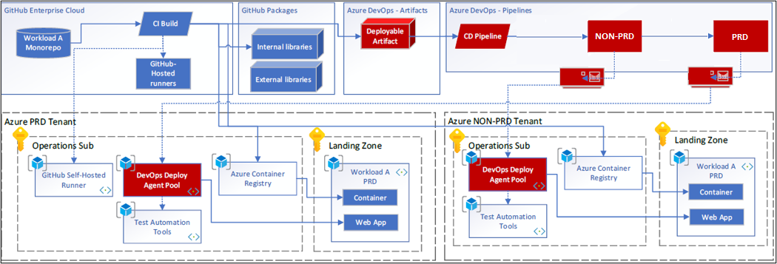
CDS overview
Continuous Integration (CI)
Continuous Delivery (CD)

Slide 7
Infrastructure As Code - High-Level

Slide 8
Definition of Infrastructure as Code (IaC)
Infrastructure as Code, is when we write secure code to create, read, update, and/or delete infrastructure in a programmatic manner.
The infrastructure must be able to be managed as virtual infrastructure via SDKs and/or APIs.
IaC is foundational to Infrastructure Automation

Slide 9
CFS approach to IaC
Bicep provides parity to ARM templates in most use cases - Microsoft is investing in Bicep’s development and is essentially an abstraction over ARM
As of v0.3, it is supported by Microsoft support plans
In some cases, some small hurdles are expected – these will be navigated with consideration for next-best practice. E.g. there are no Linting tools for Bicep – so we will compile Bicep to ARM in the CI process, and run the linter on the ARM.
For any use case where Bicep proves a significant hurdle, revert to using ARM templates for that use case, in order to meet timelines. It can be re-visited at a later date (e.g. new Bicep version)
Use of modules in Bicep to increase re-usability
Parameterisation of values, rather than hard-code – encourage reuse and DRY principles
Late binding of parameter values at deployment time.
Leverage a form of orchestration-as-code eg YAML to orchestrate the deployment of resources.
Use master pipelines to orchestrate the deployment of individual resources.

Slide 10
Per Solution Yaml Files
YAML file | Purpose
cfs-master-pipeline.yml | Main pipeline to deploy the core infrastructure.
agents-runners-pipeline.yml | Self-hosted Agents and Runners - deployment pipeline.
application-infrastructure-pipeline.yml | Application Infrastructure deployment pipelines. Will be in a separate repository .
e.g. application-deployment-pipeline.yml (up to each application development team) | The deployment of components of an application – the extent to which will be determined by each team. For Phase 2.1, a sample web app backed by SQL will be deployed by a single pipeline that acts as a service orchestrator. App Dev Teams may choose to use a single pipeline or multiple pipelines depending on their needs. Component examples: SQL/SQL-PaaS, ServiceBus, Azure Functions, Azure Logic Apps, WebAPI, Web Front-end, Backend-for-Frontend.

Slide 11
Source Code Management

Slide 12
Source Code Management (SCM)
Target state: GitHub Enterprise AE – not yet in GA in Australia.
Interim state: GitHub Enterprise Cloud (with EMU enabled)
EMU: Enterprise Managed Users – this provides a different SSO experience to standard GitHub Enterprise Cloud. Users are completely managed in Azure Active Directory. Users are not GitHub native users, and won’t have a public profile, nor have ability to create public repositories using that user.
Rationale: CFS has been using GitHub Ent Server whilst under CBA. It makes operational sense to retain GitHub for SCM. GitHub Enterprise Cloud is inline with CFS direction to maximise adoption of SaaS

Slide 13
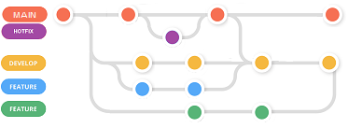
Branching Strategy
Branching allows team members to work on a common codebase with minimal disruption to others and provide a process to incorporate changes into a common branch.
Vary in complexity, and should support team effectiveness, not impede.
Complex branching such Gitflow need to be backed by solid release management processes
The branching strategy may change as the project matures.
Decision: Use a lightweight variation of Gitflow branch workflow (see “Comparison” slide). Feature branches will merge to Develop branch which is the CI branch. Develop branch will be merged to Main, which represents a future deployment to production. Where required, hotfixes can be applied to Main, and merged back into develop branch.

Slide 14
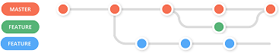
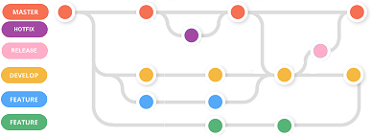
Comparison - Branching Workflows
Branch workflow | Details | Pros | Cons
Trunk Based | Single branch to which developers push their changes | Simple workflow | Doesn’t accommodate pull-request Very likely developers’ changes will disrupt their peers.
Feature Branch strategy | Feature branches merged into main/master branch after developer decides the feature is ready (via pull-request). | Allows individual developers to work with minimal disruption to others | Depending on the nature of team and the project, the strategy may be too light-weight.
Gitflow | Main/master and Develop branches as long-running branches. Feature branches are merged into develop branch. Release branches created from develop branch and merged into main/master branch. Other branches: hotfix, bugfix. | Ability to accommodate multiple concurrent releases in testing A subset/lightweight variation of Gitflow can be used and adapted as needed. E.g. We can use main/master, develop, and feature branches, and not use the release branches. | Full Gitflow needs to be supported with appropriate release management process More complex

Slide 15
Pull Request process
Definition: A request to “pull” code from another branch.
Completing a pull request results in merging code from one branch onto the target branch.
Pull request conditions can vary per repository and branch, should be customized to suit the type of work and the team characteristics
“Pull Request builds” versus “Release builds”
For VDC, these are proposed:
Code review and approvals by at least 2 peers
All code review comments (if any) need to be resolved
CI build needs to pass and quality checks need to be successful
See Branch Protection slide for complete list

Slide 16
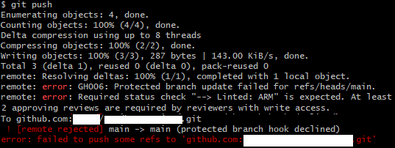
Branch protection
The lightweight variant of the Gitflow branch workflow has these branches: main, develop and feature/*
The main and develop branches will have branch protection rules in place:
Require a pull request before merging
Require approvals
Required number of approvals before merging:2
Dismiss stale pull request approvals when new commits are pushed
Require status checks to pass before merging
Require branches to be up to date before merging
Status checks that are required:
Require conversation resolution before merging
Include administrators
Restrict who can push to matching branches
Example of branch protection.

Slide 17
CI and CD

Slide 18
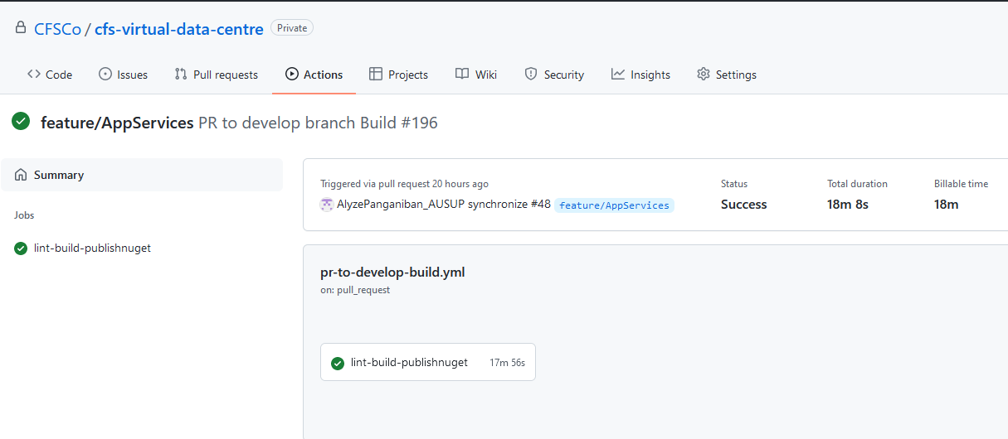
Continuous Integration
GitHub Actions - Closer to the source code
GitHub Actions workflows are YAML files committed to code repository.
Linting (Checkov)
Communicate quality to the consumer

Slide 19
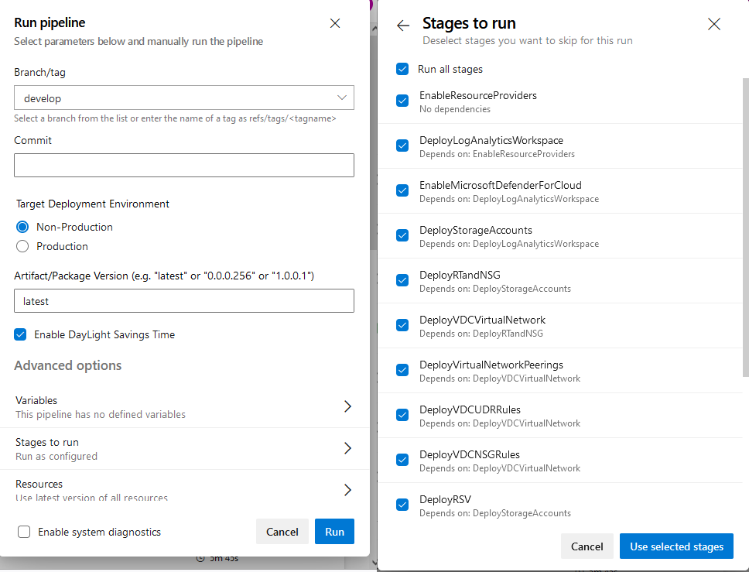
Continuous Delivery
Azure DevOps “Pipelines” are YAML – pipeline as code
Azure DevOps “Pipelines” for CD
Azure DevOps “Releases”
are classic pipelines, are configured via UI, and can be exported/imported.
are not YAML
will not be used at this stage
The release management process ties in with choice of CD at the time.
May change as project matures.
Deployments across non-prod and prod tenants will have approval workflows in place
Late binding of deployment parameters/variables.

Slide 20






IaC, CI, CD – Putting it together
Deployment Packages
x-As-Code
Code Linting (IaC)
Create Package
Azure
Artifacts
Pipelines
as code
GitHub
workflows
Bicep
Azure DevOps
Pipelines
GitHub
Actions
GitHub
Source Code
Management
Continuous
Integration
Continuous
Delivery

Slide 21
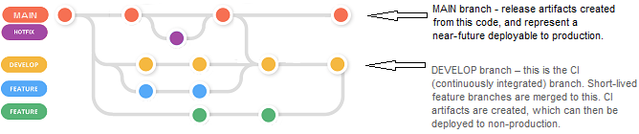
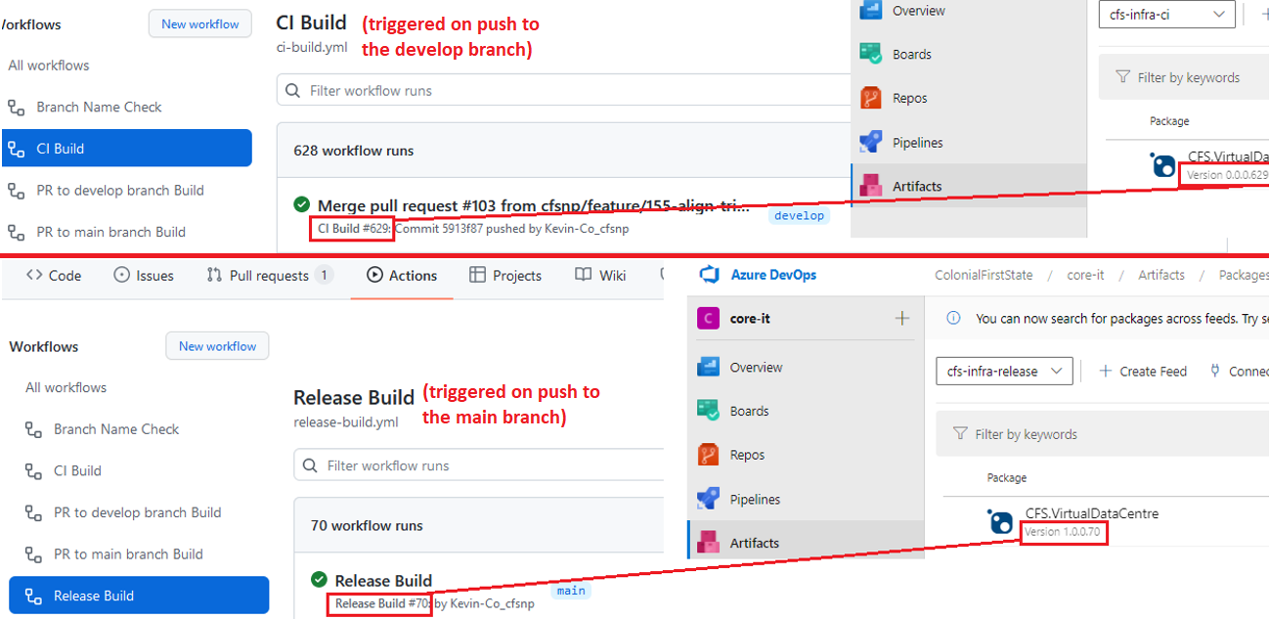
CI, CD and branching
DEVELOP branch – this is the CI (continuously integrated) branch. Short-lived feature branches are merged to this, and CI artifacts are created, which can then be deployed to non-production.
MAIN branch - release artifacts created from this code, and represent a near-future deployable to production.

Slide 22
Azure DevOps Agents
GitHub Actions Runners
Notes:
Modified/added for phase 2.1

Slide 23
Provider-Hosted vs Self-Hosted Agents and Runners
In phase 1, for both GitHub and Azure DevOps, provider-hosted agents will be used.
In cases where customisations to the agents are required, self-hosted agents will be set up on Azure Virtual Machines (phase 2.1). Considerations include:
Consumption cost
Agent idle times.
Auto-shutdown of VMs outside of business hours
Downside of provider-hosted agents:
Less control of specific tool versions.
We expect provider-hosted agents will be sufficient for IaC in phase 1.
Phase 2.1 will implement self-hosted agent/runner deployments.
Service Connections (azure subscriptions access) will be used in deploy pipelines
Notes:
Modified/added for phase 2.1

Slide 24
Self-Hosted Agents and Runners - 1/2
In Phase 2.1, automated deployment of self-hosted agents and runners.
Production GitHub and Production Azure DevOps Only : After Phase 1, we only utilise the production Azure DevOps organisation, and the production GitHub Enterprise/Organisation. Agents and runners will be registered to prod GitHub and prod Azure DevOps.
GitHub Runner VMs will be hosted in the prod Azure tenant.
Azure DevOps Agents will be hosted in the prod and non-prod Azure tenants. The purpose is to allow IaaS modifications within the Azure environment, where Azure CLI does not serve this purpose.
For BAU, the agents/runners will be registered with the Default pool/runner group.
For Testing, we will not be using the non-production Azure, ADO and GitHub as a test platform. The approach for testing changes/improvements: register the VMs to a ‘Test Pool’ pool or ‘Test Runner Group’ runner group. Those VMs will have different names to ones registered to the Default pool/runner group. These can be tested on those test pools/runner groups, without disruption to existing teams which will have their GitHub Actions and ADO pipelines running on provider-hosted agents/runners or the self-hosted ones in the “Default” pool.
Go into the Operations spoke, under a different subnet to the AVD subnet.
In ADO, Agents and Agent Pools are at Organisation-level (https://dev.azure.com/ausup/_settings/agentpools).
In GH, Runners are possible at enterprise-level, org-level or repo-level.
GH: Runner Groups are possible at either enterprise-level or org-level.
GH: Phase 2.1 will proceed with creation of org-level runners, which allows for allocation to Runner Groups and offers better standardisation of tooling.
GH: The phase 2.1 code/pipelines can be re-purposed to further customise agents/runners specific to the needs of the teams consuming them.
Notes:
Modified/added for phase 2.1

Slide 25
Self-Hosted Agents and Runners 2/2
For Phase 2.1, we will use the self-hosted runners/agents to build/deploy the sample 2-tier web application.
We will have Azure CLI installed and expect to be able to do future IaaC deployments. It's a chicken and egg scenario with what will be deployed with them. Obviously, we won't use self-hosted agents to deploy/create the self-hosted agents.
Auto-shutdown: initially, use 9pm AEST/AEDT.
Testing: build the sample web app that is part of phase 2.1 deliverables.
One YML pipeline to create agent/runner VMs, register with ADO/GH, install tools
Separate YML pipeline that takes an array parameter container VM hostnames to deregister and delete the resource group (separate stages that can be selected for deployment).
Notes:
Modified/added for phase 2.1

Slide 26
Tools installation on Self-Hosted Agents and Runners
Base OS – Windows 11
Provider-hosted GitHub runners and Azure DevOps agents have a comprehensive toolset spanning 100+ applications: https://github.com/actions/virtual-environments/blob/main/images/win/Windows2022-Readme.md
Toolset for phase 2.1:
.NET Core SDK / Runtime – minimum version 6.0.200
Git – minimum version 2.35.1.windows.2
Azure CLI – minimum version 2.34.1
PowerShell 5 – the PowerShell 5 version that comes stock in the VM image.
PowerShell 7 – minimum version 7.2.1
Can leverage the following scripts:
.NET Core SDK / Runtime: https://docs.microsoft.com/en-us/dotnet/core/tools/dotnet-install-script (./dotnet-install.ps1 -Version '6.0.200')
Others: https://github.com/actions/virtual-environments
High level approach for tools updates on the agents:
Create/modify the necessary code for upgrading the tools or agent software (post-phase 2.1);
Deploy to a test pool (pipelines will be implemented to support this – e.g. via a “Test Pool” flag);
Test the agent’s tools using a sample pipeline;
Once tested, deregister the existing agent instances that require upgrading, then delete the VMs and related resources (each will have their own resource group, so we can delete at that level);
Deploy new agents with the upgraded tools into the mainstream pool.
Notes:
Modified/added for phase 2.1

Slide 27
GitHub Actions Runners - Firewall rules
GitHub Actions runners: firewall rules to allow outbound port 443 to the following FQDNs (https://docs.github.com/en/actions/hosting-your-own-runners/about-self-hosted-runners#communication-between-self-hosted-runners-and-github)
FQDN Destination | Protocol | Source Type | Source (non-prod) | Source (prod)
github.com | https | IP Group | ig-sub-np-edc-operations-002 | ig-sub-prd-edc-operations-002
api.github.com | https | IP Group | ig-sub-np-edc-operations-002 | ig-sub-prd-edc-operations-002
codeload.github.com | https | IP Group | ig-sub-np-edc-operations-002 | ig-sub-prd-edc-operations-002
objects.githubusercontent.com | https | IP Group | ig-sub-np-edc-operations-002 | ig-sub-prd-edc-operations-002
objects-origin.githubusercontent.com | https | IP Group | ig-sub-np-edc-operations-002 | ig-sub-prd-edc-operations-002
github-releases.githubusercontent.com | https | IP Group | ig-sub-np-edc-operations-002 | ig-sub-prd-edc-operations-002
github-registry-files.githubusercontent.com | https | IP Group | ig-sub-np-edc-operations-002 | ig-sub-prd-edc-operations-002
*.blob.core.windows.net | https | IP Group | ig-sub-np-edc-operations-002 | ig-sub-prd-edc-operations-002
*.actions.githubusercontent.com | https | IP Group | ig-sub-np-edc-operations-002 | ig-sub-prd-edc-operations-002
Communication is initiated by the runner, via HTTPS/TLS, using a long poll of 50 seconds. After expiry, it will reinitiate another poll.
It is recommended that only private repositories are used by self-hosted runners – public repos present the risk of running external/uncontrolled code/scripts.
Notes:
Modified/added for phase 2.1

Slide 28
Azure DevOps Agents - Firewall rules
Azure DevOps Agents: firewall rules to allow outbound port 443 to the following FQDNs and IP ranges (https://docs.microsoft.com/en-us/azure/devops/pipelines/agents/v2-windows?view=azure-devops)
FQDN Destination | Protocol | Source Type | Source (non-prod) | Source (prod)
dev.azure.com | https | IP Group | ig-sub-np-edc-operations-002 | ig-sub-prd-edc-operations-002
*.dev.azure.com | https | IP Group | ig-sub-np-edc-operations-002 | ig-sub-prd-edc-operations-002
login.microsoftonline.com | https | IP Group | ig-sub-np-edc-operations-002 | ig-sub-prd-edc-operations-002
management.core.windows.net | https | IP Group | ig-sub-np-edc-operations-002 | ig-sub-prd-edc-operations-002
vstsagentpackage.azureedge.net | https | IP Group | ig-sub-np-edc-operations-002 | ig-sub-prd-edc-operations-002
vssps.dev.azure.com | https | IP Group | ig-sub-np-edc-operations-002 | ig-sub-prd-edc-operations-002
Destination IPs | Protocol / Destination Ports | Source Type | Source (non-prod) | Source (prod)
13.107.6.0/24 | TCP / 443 | IP Group | ig-sub-np-edc-operations-002 | ig-sub-prd-edc-operations-002
13.107.9.0/24 | TCP / 443 | IP Group | ig-sub-np-edc-operations-002 | ig-sub-prd-edc-operations-002
13.107.42.0/24 | TCP / 443 | IP Group | ig-sub-np-edc-operations-002 | ig-sub-prd-edc-operations-002
13.107.43.0/24 | TCP / 443 | IP Group | ig-sub-np-edc-operations-002 | ig-sub-prd-edc-operations-002
Notes:
Modified/added for phase 2.1

Slide 29
Tools installation on Agents / Runners - Firewall rules
In order to allow tools installation, the firewall rules need to allow outbound port 443 to the download URLs’ FQDNs.
Preliminary list
FQDN Destination | Protocol | Source Type | Source (non-prod) | Source (prod)
dot.net | https | IP Group | ig-sub-np-edc-operations-002 | ig-sub-prd-edc-operations-002
aka.ms | https | IP Group | ig-sub-np-edc-operations-002 | ig-sub-prd-edc-operations-002
More - TBC during the build
Notes:
Modified/added for phase 2.1

Slide 30
Application Infrastructure (PaaS)
Notes:
Modified/added for phase 2.1

Slide 31
Application Infrastructure (PaaS)
Separate code repository/ies to allow application development teams to add / modify code for their application infrastructure.
This eliminates the need to grant them contributor/writer access to Core IT’s “cfs-virtual-data-centre” repository, and avoid having to give application developers visibility of core infrastructure, or ability to modify it.
Core IT team will also contribute to the application infrastructure repository, initially, and from time to time as required.
For transparency, and to reduce administrative overheads, it is recommended the separate code repository house all such application infrastructure that has consumption on a broad scale in the organization. That is – as opposed to each development team provision their own Azure App Service Environment.
Notes:
Modified/added for phase 2.1

Slide 32
Applications and Application Testing
Notes:
Modified/added for phase 2.1

Slide 33
Sample 2-tier web app – hosted on Azure App Service and SQL PaaS
Use a sample 2-tier web app from Microsoft / Azure samples: sample: https://github.com/Azure-Samples/msdocs-app-service-sqldb-dotnetcore tutorial: https://docs.microsoft.com/en-us/azure/app-service/tutorial-dotnetcore-sqldb-app?tabs=azure-portal%2Cvisualstudio-deploy%2Cdeploy-instructions-azure-portal%2Cazure-portal-logs%2Cazure-portal-resources
Use a dedicated application repo for the application code.
Web App Service PaaS code / config to be in the application repo.
SQL PaaS code / config to be in the application repo.
For simplicity, trunk-based branching will be adopted for this sample.
GitHub Action to build and package the binaries into a versioned Nuget package and publish to Azure Artifacts ready for deployment.
The version number will be a derivation of the GitHub Action build number.
Config will be dynamic to allow late binding of config parameter values (in the CD process).
Notes:
Modified/added for phase 2.1

Slide 34
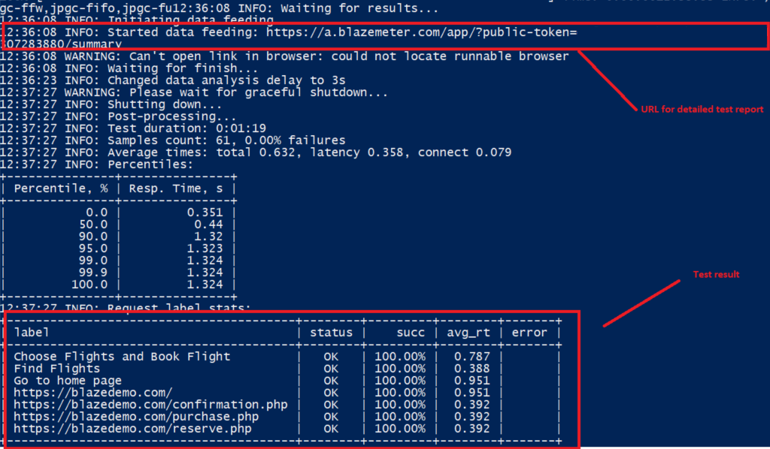
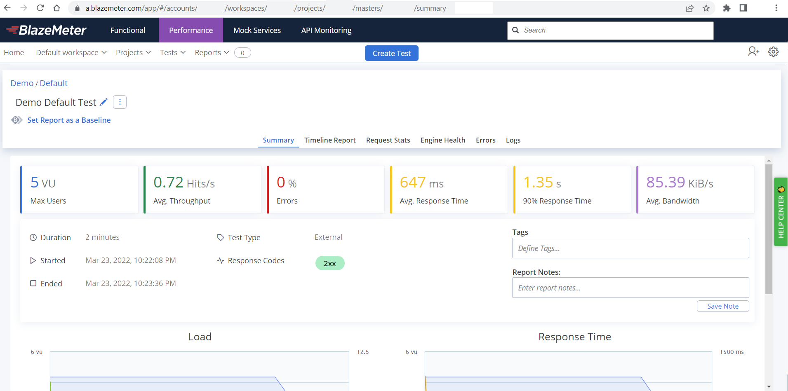
BlazeMeter tests
Create BlazeMeter tests using Jmeter for a sample / demo website.
Apache Jmeter JMX files will be created and commit in the code.
The website to be tested may not necessarily be the sample two-tier app being built in phase 2.1 - there are very suitable demo websites available e.g. https://blazedemo.com/
The account at BlazeMeter is used to store statistics of the performance tests.
An Azure DevOps pipeline will run the tests and the results will be available in the BlazeMeter account.
Notes:
Modified/added for phase 2.1

Slide 35
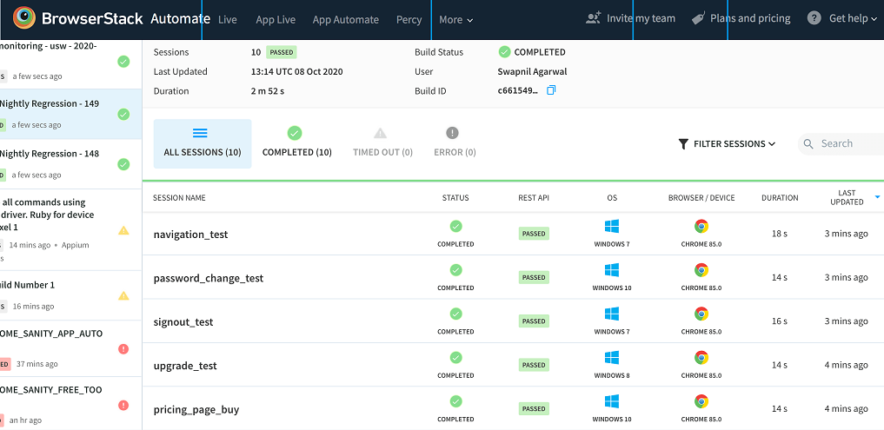
BrowserStack tests
Write Selenium tests (using C# language) and commit into the code base.
The tests can also be run locally on developer machine (with proper configuration of the BrowserStack credentials / access keys on the machine).
The BrowserStack platform will capture screenshots and other report metrics which can be retrieved at a later time.
An Azure DevOps pipeline will run the tests and the results will be available in the BrowserStack account.
References: https://www.browserstack.com/docs/automate/selenium/azure-pipelines
Notes:
Modified/added for phase 2.1

Slide 36
Package and artifact management
Notes:
Modified/added for phase 2.1

Slide 37
GitHub package registry
Where Azure Artifacts is used to store deployable artifacts, GitHub package registry will be used to share common application components.
Where needed by development teams, packages will be built as part of each development team’s CI / release build processes.
This will be executed in GitHub Actions.
The build number will be incorporated into the version.
The sample package produced in phase 2.1 will be a Nuget package.
CFS can publish packages of other language/frameworks – e.g. NPM
Notes:
Modified/added for phase 2.1

Slide 38
Incorporating Additional Landing Zones
Notes:
Modified/added for phase 2.1

Slide 39
Incorporating Additional Landing Zones
Phase 2.1 will stand up additional landing zones for digital and back-office.
Distinction between the landing zone versus resources that live in the landing zone.
Given the landing zones are extensions of the existing infrastructure, leverage existing code patterns and the main “cfs-master-pipeline”.
Continue to leverage the staged pipeline approach.
New subscriptions and management groups (plus role assignment) - > new parameter (JSON) files and add new stages in the main pipeline.
New vnets/subnets - > new parameter (JSON) files and add new stages/tasks in the main pipeline under the network stage.
Key Vaults - > new parameter (JSON) files and add new stages/tasks in the main pipeline under the key vault stage.
Same code repository.
Resources that live in the landing zone will be in separate “App-Infrastructure” repo/s – maybe even one per landing zone.
Notes:
Modified/added for phase 2.1

Slide 40
Security, IDAM, Access controls

Slide 41
GitHub & Azure DevOps Roles
Registration of GitHub Enterprise Cloud EMU in Azure AD, as an Enterprise App – enables SAML for SSO.
GitHub Enterprise SCIM user provisioning will be configured to allow 1 or many AAD security groups.
GitHub enterprise, organisation, code repository access will be customised to only those with membership in certain AAD security groups.
Similarly, Azure DevOps access will be determined by security groups and RBAC.
GitHub and Azure DevOps integration (GH integration with Azure Boards, GH pushing to Azure Artifacts) will be achieved via PAT tokens with the minimum scope required for the specific scenario.
Azure DevOps will have different service connections to allow deploy onto different subscriptions.
Provide subscription access only to specific teams e.g. identity for identity engineers. Need to determine a Operating Model.

Slide 42
Azure DevOps Role Assignment
Via AAD RBAC, Security Group membership managed in AAD, DevOps roles assigned based on AAD Security Groups.
Developers assigned to project contributors at project scope.
Idea is to keep access scope as limited as possible.
DevOps administrators assigned to project collection administrators.
The idea is DevOps administrators are servicing the entire enterprise.
May need to tweak the project contributor role's permissions to tighten access around pipelines.
As more teams are onboarded on other projects, we can introduce different roles.

Slide 43
GitHub Role Assignment
Via AAD RBAC, Security Group membership managed in AAD, GitHub teams and roles assigned based on AAD Security Groups.
Developers for the project to be given “writer” access to the project repo, assign via GitHub team

Slide 44
Ways of Working

Slide 45
Workflow Processes and Tools
CFS currently use JIRA
Azure Boards is part of Azure DevOps - no need to setup JIRA for this first phase. CFS may choose to use JIRA at a later stage.
Azure Boards natively supports Agile processes: Scrum/Kanban
Team’s ways of working: Break up deliverables into smaller atomic units, that lends itself to parallel streams of work, and early realization of value.
Use Azure Boards to manage track implementation, test and defect activities
Capture user stories and acceptance criteria so that expectations are set prior to implementation.
Team members can wear many hats. Someone who usually does IaC development can take on testing tasks.

Slide 46
Onboarding other teams - Approach
Approach for onboarding other teams (e.g. WP2, WP3) - initial approach:
May evolve after consultation
Azure Portal
readonly access to portal, initially just non-prod
subscriptions - will use existing and new subscriptions
GitHub
Same single organisation
For TCS (WP2, WP3) – a separate/new code repository – forked from the VDC code repository
Read only access to the VDC code repository
Azure DevOps
New ADO projects (and thus pipelines) for each team – e.g. core-network, core-security.
New pipelines modelled on the CDS/VDC pipeline
In time, re-organisation (of orgs and repos) can be revisited.

Slide 47
Phase 1
Phase 2.1
Prod and non-prod ADO/GitHub (non-prod may evolve into a ‘sandpit’ environment as prod/non-prod moves into a single tenant)
GitHub actions
GitHub SAML/SCIM integration
Code Linting
Pipelines (YAML) and infra as code (Bicep)
Azure Boards for Agile/SCRUM
GitHub and ADO role definition
Phase 2.1 of the Core IT program (WP1) covers IaC for Virtual Data Centre and additional components for the DevOps ecosystem – this document is written in that context.
Self-hosted GitHub Actions runners.
Self-hosted Azure DevOps agents.
A sample 2-tier web app – hosted on Azure App Service and SQL PaaS.
Sample tests for BlazeMeter and BrowserStack.
GitHub package registry for use in CI and application development.
Post Phase 2.1
Application workloads – SonarQube, Mergie (consistent merge for trunk-based dev)
Continuous Security - GitHub Advanced Security

Slide 48
Phase 1 Decision register – CDS – 1/2
Decision ID | Summary | Decision Description | Options Considered | Decision | Rationale | Status
DEC-003 | DevOps licenses | Purchase additional licenses or leverage existing licenses |  | Free Tier of Azure DevOps allows up to 5 users. We will proceed with the free tier. | The free tier is sufficient for the team size. As team ramps up, can look at purchasing plans. | Closed
DEC-004 | Linter - Code scanning tool for Bicep templates | Which code scanning tool/librray will be used to scan Bicep templates? | Azsk AZST ARM-TTK Checkov | Use Checkov | It is available in GitHub Actions. It does not take long to run, unlike others that spin up a docker container. There is no cost. There are no tools available yet to scan Bicep templates, so any tool would require first converting to ARM templates. | Closed
DEC-012 | GitHub Enterprise | In the HLSD, it is already decided that GitHub Enterprise will be used for source control. Need confirm this is still correct. |  | 3/12/2021 - Confirmed that GitHub Enterprise will be used, starting with a trial licence for the non-prod work, delaying the purchase of a licence until needed for prod. | Inline with the HLSD, the reason is because the application teams currently use this. | Closed
DEC-038 | Number of DevOps Organisations (instances) | Preference for a single DevOps instance to promote code through non-prod to prod. May require an ongoing non-prod devops for sandpit type work |  | 7/12/2021 - ADRF endorsed: * Single Azure DevOps as long as we have appropriate control controls to minimise unintended change. * A development Azure DevOps pipeline will be required to test components of the pipeline itself in the nonprod Azure tenancy. Use of this development Azure DevOps pipeline will limited to VDC Service Provider |  | Closed
DEC-046 | For Continuous Integration of IaC, can we use Azure Pipelines instead of GitHub Actions? | The HLSD specifies GitHub Actions. For IaC in phase 1, will the use of Azure piplines for IaC be acceptable? |  | After some investigations and POC, good to proceed with GitHub Actions for CI | POC was done | Closed
DEC-066 | Confirm GitHub Enterprise Cloud or GitHub AE for WP1 phase 1 | The HLSD has GitHub Enterprise Cloud (GHEC) as interim, until such time GitHub Enterprise AE is available (roadmap was March 2021). |  | 9/12/2021 Soumith will check: Is GitHub AE general availablility in Australia with the features required by CFS? 16/12/2021 - Kevin updated Soumith Standard GitHub Enterprise Cloud (without EMU) has risk of public respositories (public user respositories). Enterprise Managed Users (EMU) has the option to turn that off at enterprise/organisation-level. To get EMU provisioned, need to talk to GitHub sales team rep. 20/12/2021 The GitHub account team has provisioned trial of GitHub Enterprise Cloud with EMU. We have a path forward. |  | Closed

Slide 49
Phase 1 Decision register – CDS – 2/2
Decision ID | Summary | Decision Description | Options Considered | Decision | Rationale | Status
DEC-067 | GitHub Enterprise Cloud/Server free trials | GitHub Enterprise Cloud (GHEC) offers a 14-day free trial, after which it will be downgraded to "GitHub Free" with limited features. GitHub Enterprise Server (GHES) offers a 45-day free trial, can be extended by contacting sales team. HLSD has GitHub Enterprise Cloud as interim platform, with GitHub Enterprise AE as the target state. The 14-day trial of GHEC isn't sufficient, so we need an option to get this extended, or get funding for an enterprise licence. |  | Soumith will check lics and versions with CFS 20/12/21: Going ahead using trial of GitHub Enterprise Cloud with EMU |  | Closed
DEC-080 | Do self-hosted agents need to be built on an CFS-approved hardened vm image? | During phase 1, are the self-hosted build agents (wherever necessary) required to be built on CFS-approved hardened VM image - with Qualys and the like? |  | Not a concern as it's unlikely we will require self-hosted agents |  | Closed
DEC-084 | Bicep templates vs ARM templates | Bicep v0.3+ has feature parity with ARM, however we may find certain use cases where Bicep doesn't achieve the desired result. Do we go ahead with Bicep templates? | Bicep, ARM, Terraform | Proceeding with Bicep. Decision to be reviewed on a per use-case basis, and ARM template used where Bicep doesn't give the desired result. |  | Closed
DEC-135 | Manual Test approach and tooling | This relates to the manual execution of test scripts. What will be the testing/workflow tools used? | * Test Plans in Azure DevOps (requires licenced users) * Use test stories in Azure Boards | Use test stories in Azure Boards | The nature of the project and team are such that Test Plans is not necessary. Test Plans will require paying a fee per user. We have test stories already, and is sufficient to capture the Acceptance Criteria and test results. | Closed

